Slide 1
Git and GitHub

Slide 2
What is “git”?
Git is a free and open-source distributed version control system that is widely used for software development. It was created by Linus Torvalds in 2005 to manage the development of the Linux kernel. Git allows developers to keep track of changes made to code over time, collaborate with others on the same project, and revert to previous versions of the code if necessary. It uses a decentralized architecture, where each developer has their own copy of the codebase and can make changes independently, while the system tracks the history of changes and enables easy merging of changes from different contributors. Git is used by many popular software development platforms such as GitHub, Bitbucket, and GitLab, and has become an essential tool for modern software development.

Slide 3
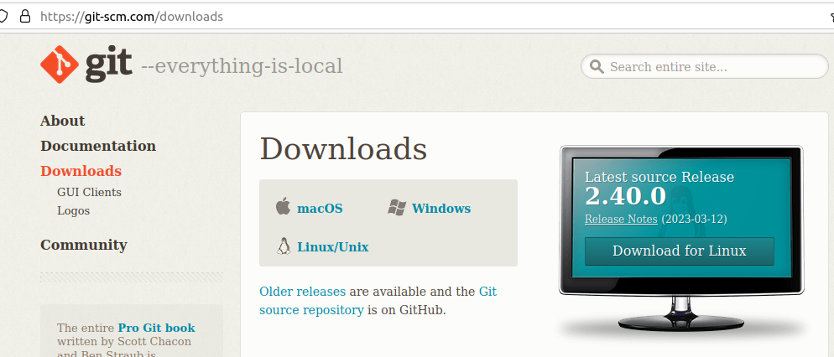
How to use Git? Downlod Git-SCM.
https://git-scm.com/downloads

Slide 4
What is GitHub?
GitHub is a web-based platform that provides hosting for software development version control using Git. It allows developers to store and share their code, collaborate with others on projects, track changes to code over time, and manage project workflow. GitHub provides a variety of tools and features to support software development, including issue tracking, code review, and project management tools.
GitHub has become an essential platform for open-source software development, as it provides a centralized location for developers to share their code, collaborate with others, and contribute to existing projects. Many popular open-source projects, including the Linux kernel and the Ruby on Rails web framework, are hosted on GitHub. In addition, many companies and organizations also use GitHub as a platform for their own software development, both for open-source and proprietary projects.

Slide 5
Some “git” commands
“git clone”
“git pull”
“git checkout <branchname>”
“git status”
“git add”
“git commit”
“git push”
“git branch”
“git rm”: The git rm command can be used to remove individual files or a collection of files. The primary function of git rm is to remove tracked files from the Git index. Additionally, git rm can be used to remove files from both the staging index and the working directory.

